Slide 1
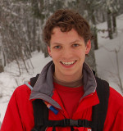
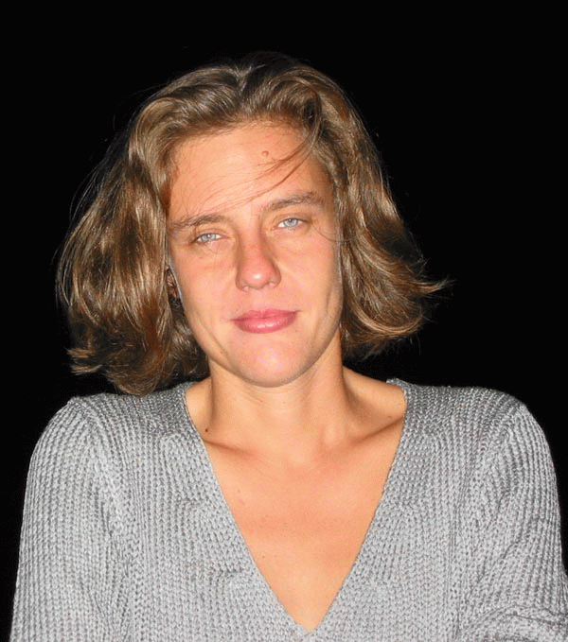
Metric learning approaches
for image annotation
and face recognition
Jakob Verbeek LEAR Team, INRIA Grenoble, France
Joint work with : Matthieu Guillaumin Thomas Mensink Cordelia Schmid
Notes:
1

Slide 2
Similarities appear in many places in vision
Matching: Distances between (local) image descriptors
wide baseline matching, image retrieval, …
Clustering: Distance between data points and cluster centres
Visual dictionary construction, object discovery, …
Classification: Kernels between images
Object recognition, localization, …
Notes:
2

Slide 3
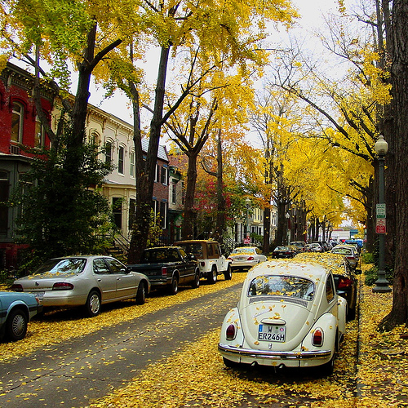
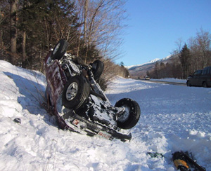
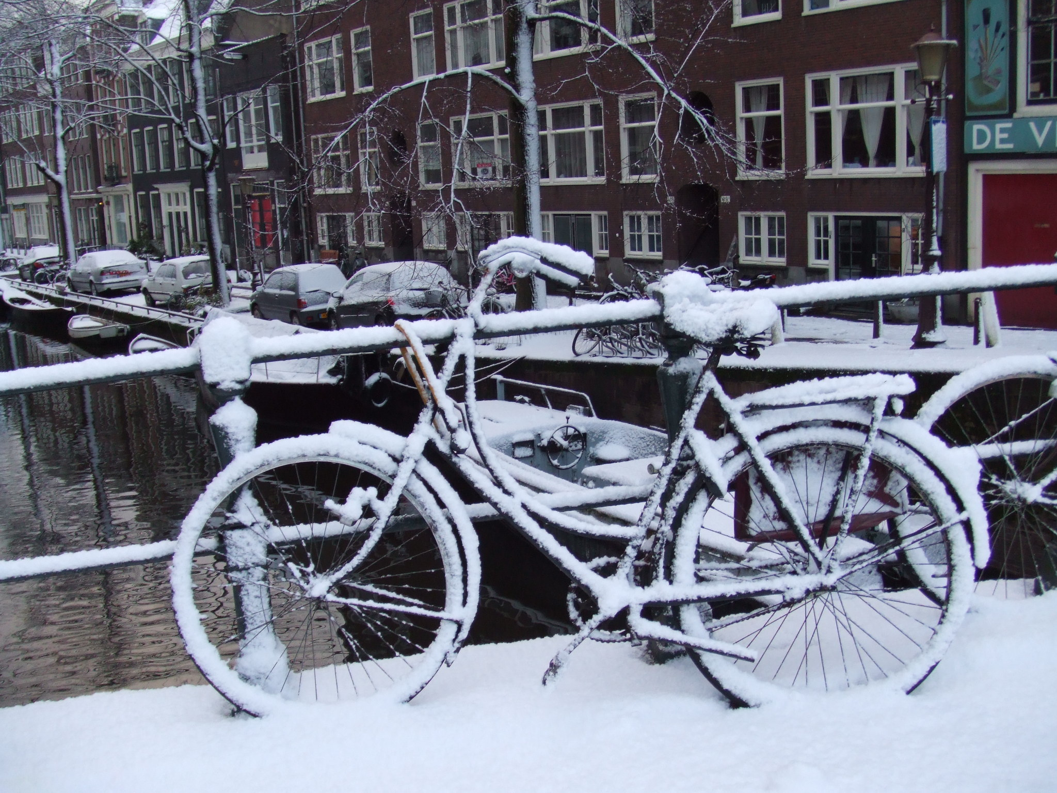
Metric Learning
Acquisition of measures of distance or similarity from examples
Which things are similar depends on the task
While visual features are often quite generic
season
scene type
objects
Notes:
3

Slide 4
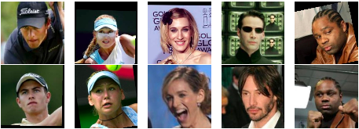
Problem 1: Face verification
Are these two faces of the same person?
Challenges:
pose, scale, lighting, ...
expression, occlusion, hairstyle, ...
generalization to people not seen during training
Notes:
4

Slide 5
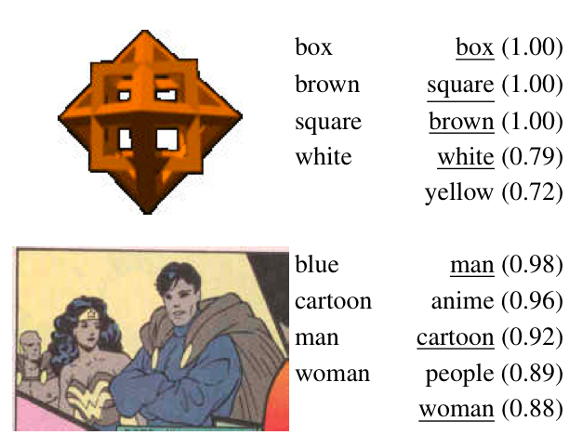
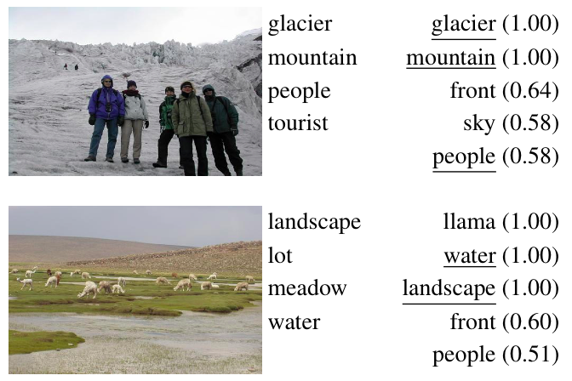
Problem 2: image annotation
Predicting the relevance of keywords for images
Ranking keywords for an image
Ranking images for keywords
Notes:
5

Slide 6
Overview
Metric learning methods
Metric learning for image annotation
Metric learning for face verification
Application to face clustering
Application to caption-based recognition
Notes:
6

Slide 7
Metric Learning
Euclidean or L2 distance is probably the most well known
Most common form of learned metrics are Mahalanobis
M is a positive definite matrix
Generalization of Euclidean metric (setting M=I)
Corresponds to Euclidean metric after linear projection of data
Not all methods fit this formulation of fixed vectorial data representation, eg based on matching image regions [Nowak & Jurie 2007]
Notes:
7

Slide 8
Metric Learning: different forms of M
Full: quadratic number of parameters
Diagonal: distance is a weighted sum of L2 distances computed on each dimension of the input vectors
Block diagonal: distance is a sum of Mahanalobis distances on different groups of dimensions (eg for different image descriptors)
Low rank: M = L^{T}L, where L is a (d x D) matrix, performs dimensionality reduction via linear projection
x
Notes:
8

Slide 9
Metric Learning: different learning objectives
Fisher’s Linear Discriminant Analysis: linear projection to minimize within-class variance, maximize between-class variance [Bishop 2006]
Assumes Gaussian distribution of the data of each class
Large Margin Nearest Neighbour metrics: force the nearest neighbours of each data point to be of the same class [Weinberger et al 2005]
Many more methods exist, for a recent survey see [Yang & Jin 2006]
Notes:
9

Slide 10
Overview
Metric learning methods
Metric learning for image annotation
Metric learning for face verification
Application to face clustering
Application to caption-based recognition
Notes:
10

Slide 11
Problem 1: image annotation
Predicting the relevance of keywords for images [Guillaumin et al 2009a]
Ranking keywords for an image for (semi) automatic annotation
Ranking images for keywords to enable keyword based retrieval
For test image transfer annotations of most similar training images
Notes:
11

Slide 12
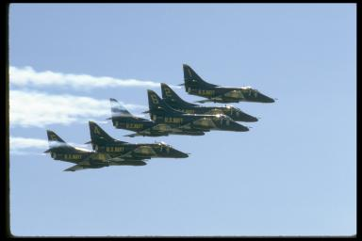
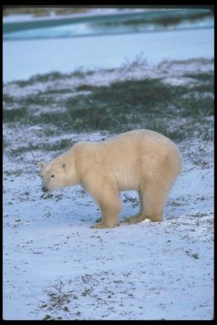
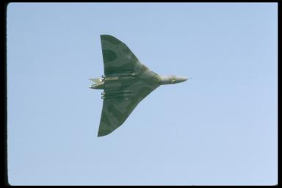
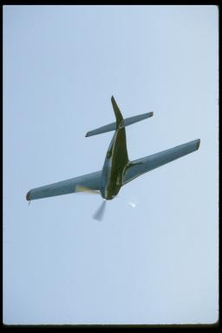
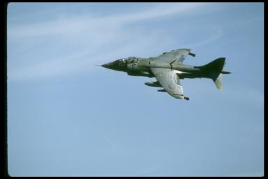
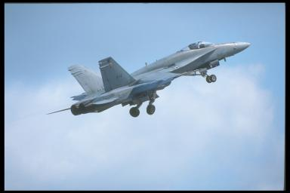
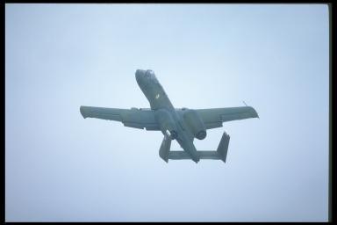
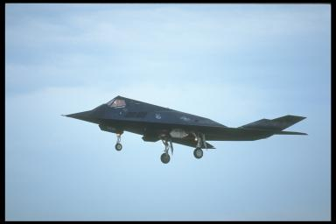
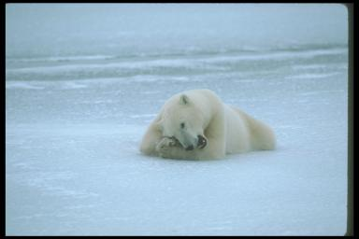
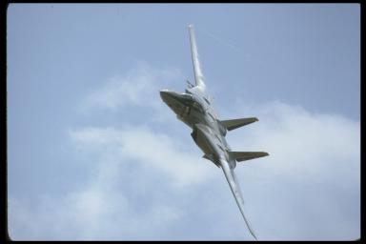
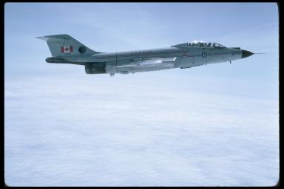
Nearest neighbour image annotation
Take k neighbours, average their annotations
Confidence score is fraction of neighbours annotated with the word
jet
plane
smoke
Jet ? : 7/11
bear
polar
snow
tundra
sky
plane
prop
sky
jet
plane
clouds
jet
plane
sky
jet
plane
sky jet plane
clouds jet plane
bear polar
snow ice
sky jet plane
Notes:
12

Slide 13
Nearest neighbour image annotation
How many neighbours to use ?
Which distance to define neighbours?
jet
plane
smoke
Jet ?
bear
polar
snow
tundra
sky
plane
prop
sky
jet
plane
clouds
jet
plane
sky
jet
plane
sky jet plane
clouds jet plane
bear polar
snow ice
sky jet plane
Notes:
13

Slide 14
Nearest neighbour image annotation
Nearest neighbour prediction for annotation bit
Generalizing Nearest Neighbour prediction
Relax the equal weighting of the k neighbours
Allow combination of multiple distances
kNN obtained by setting weight to 1/K if j among K neighbours
Learn weights using maximum likelihood criterion
Annotations of train images
Notes:
14

Slide 15
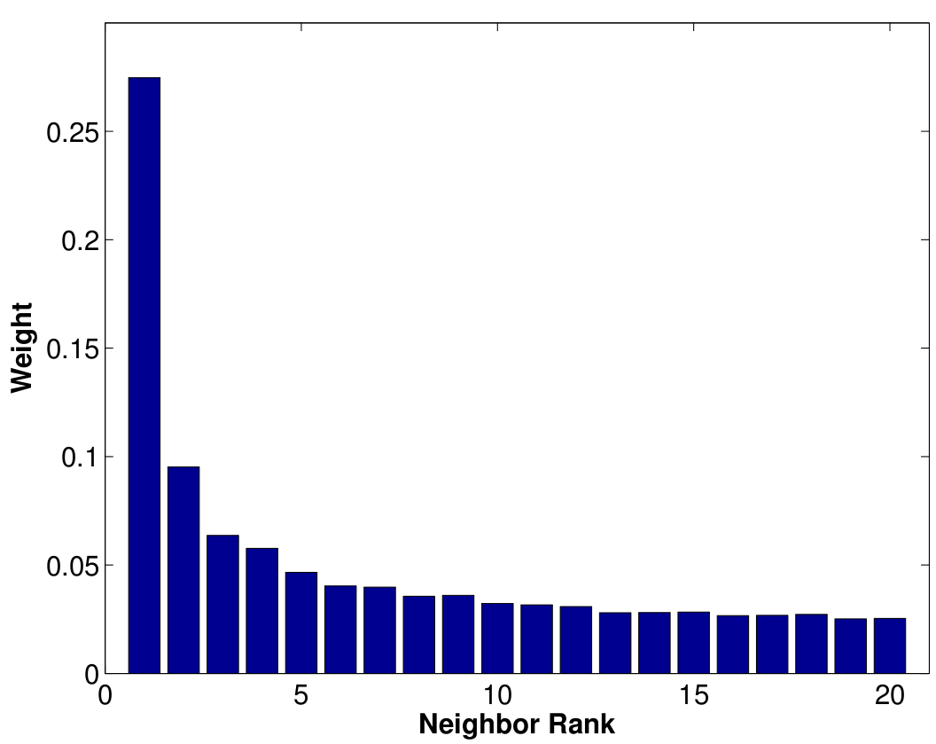
Rank-based nearest neighbour weights
Prediction from weighted neighbours
Rank-based weighting: let r_{j} denote the neighbour rank of train image j
Learn weight w_{k} for each rank k
Multiple distances easily combined with weights for each combination of distance and rank
Notes:
15

Slide 16
Distance-based nearest neighbour weights
Prediction from weighted neighbours
Distance-based weighting: let d_{j} denote distances to train image j
Learn single parameter that sets decay of weight with distance
More generally we can learn a distance metric
Notes:
16

Slide 17
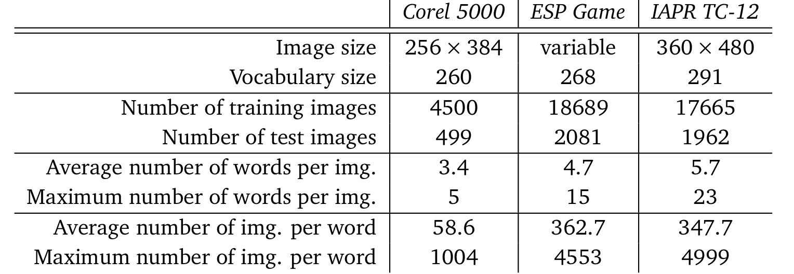
Experimental evaluation
Features extracted on each image, leading to image 15 distances
Gist descriptor
Colour histograms (3 color spaces, full image + 3x1 spatial grid)
Local descripors (SIFT + Hue, dense + Harris, full im + 3x1 grid)
Metric learning: find weighted sum of 15 base distances
Data sets
Notes:
17

Slide 18
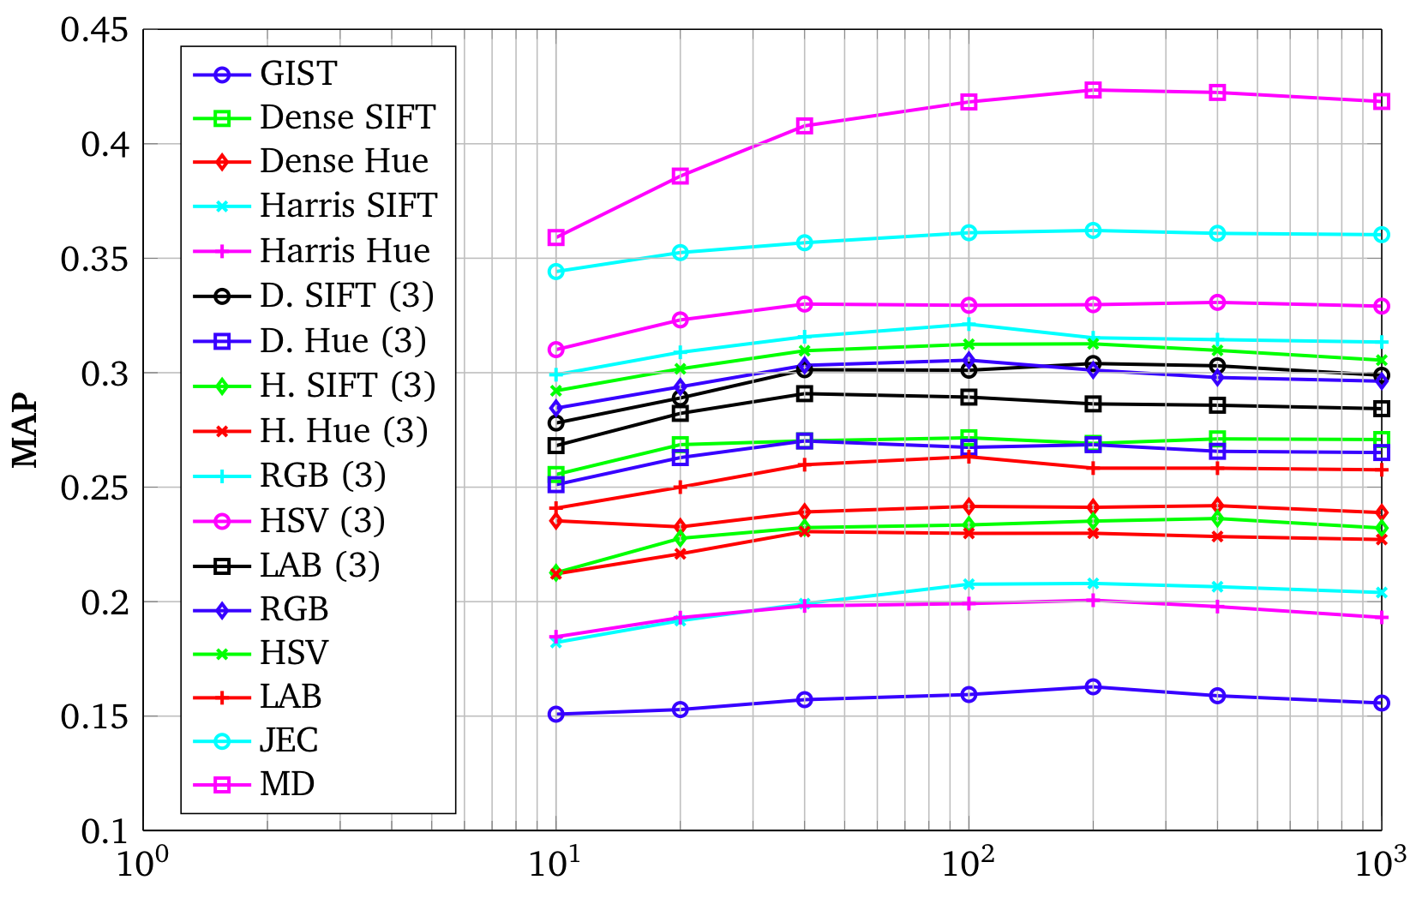
Image retrieval performance per keyword
Performance of individual features, joint equal combination (JEC), and learned distance combination (MD), varying number of neighbours
Notes:
18

Slide 19
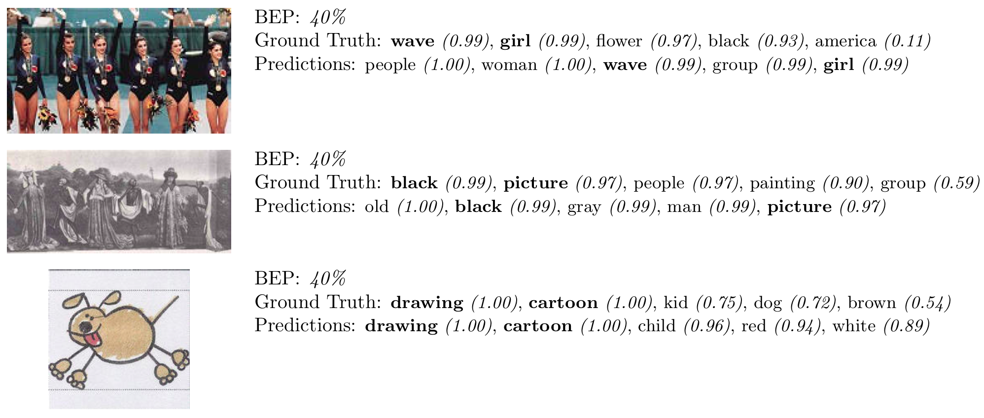
Image annotation examples (ESP)
Ground truth and predicted annotations (Correspondences in bold)
Notes:
19

Slide 20
Image retrieval performance (MIR-Flickr)
Varying # neighbours
Distance vs Rank weights
Single vs multiple dists
62 NN x 16 dists = 992
Notes:
20

Slide 21
Image retrieval performance (ImageCLEF’10)
Combining visual and textual (Flickr user tags) features
Linear SVM vs Rank-based TagProp
AP scores over 93 annotation concepts
Method | Features | Map
SVM | V+T | 45.5
TagProp | V+T | 43.7
MEIJI | V+T | 32.6
SVM | V | 39.0
TagProp | V | 36.4
Un. Amsterdam | V | 40.7
Notes:
21

Slide 22
Overview
Metric learning methods
Metric learning for image annotation
Metric learning for face verification
Application to face clustering
Application to caption-based recognition
Notes:
22

Slide 23
Problem 2: face verification
Are these two faces of the same person?
Challenges:
pose, scale, lighting, ...
expression, occlusion, hairstyle, ...
generalization to people not seen during training
Notes:
23

Slide 24
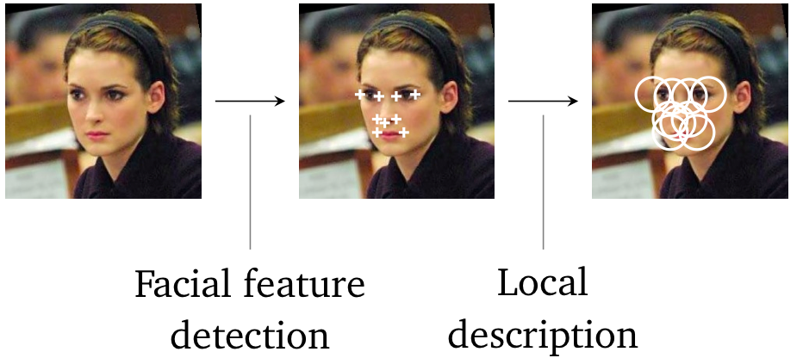
Face verification experiments
Realistic intra-person variability: Labelled Faces in the Wild data set
Contains 12.233 faces of 5749 different people
Task: predict for pair of faces whether they are the same person or not
Pairs used in test are of people not in the training set
Feature extraction process
Detection of 9 facial features using
both appearance and relative position
[Everingham et al. 2006]
Each facial features described using SIFT descriptors at 3 scales
Concatenate 3x9 SIFTs into a vector of dimensionality 3456
Notes:
24

Slide 25
Facial feature extraction process
Notes:
25

Slide 26
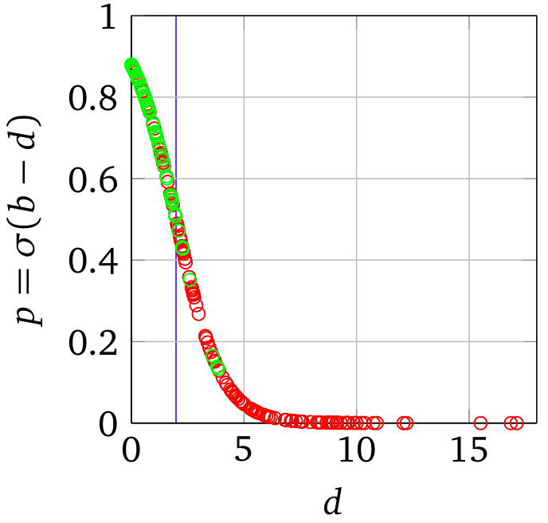
Logistic Discriminant Metric Learning
Classify pairs of faces based on a learned distance metric
Use sigmoid to map distance to class probability [Guillaumin et al 2009b]
Linear logistic discriminant model
Distance is linear in elements of M
Learn maximum likelihood M
Can use low-rank M =L^{T}L to avoid overfitting
Loses convexity of cost function
Notes:
26

Slide 27
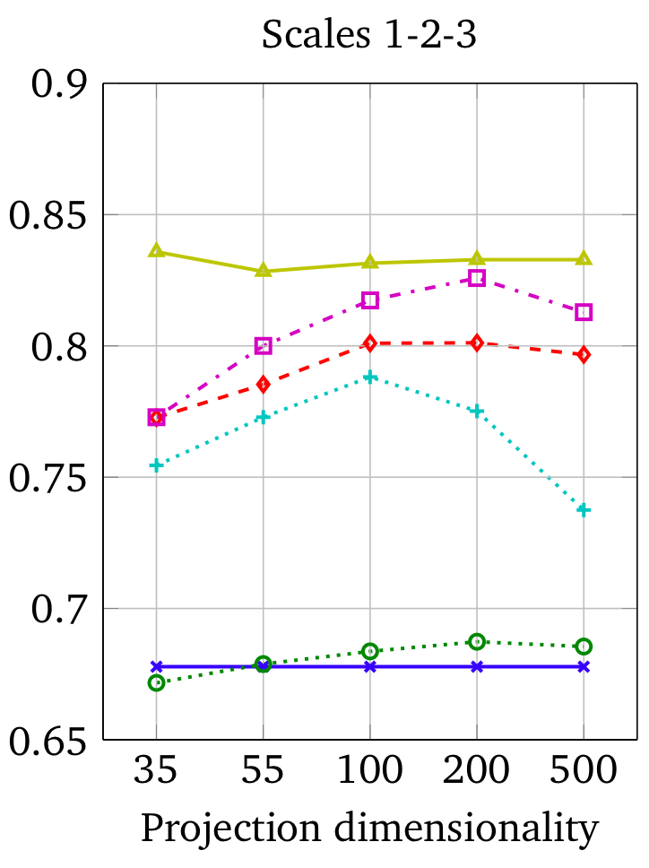
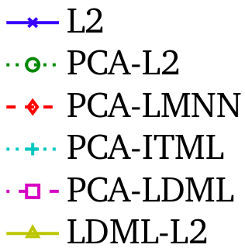
Experimental Comparison on Verification Task
Significant increases in performance when learning the metric
Low-rank metric needs less dimensions to learn good metric
Notes:
27

Slide 28
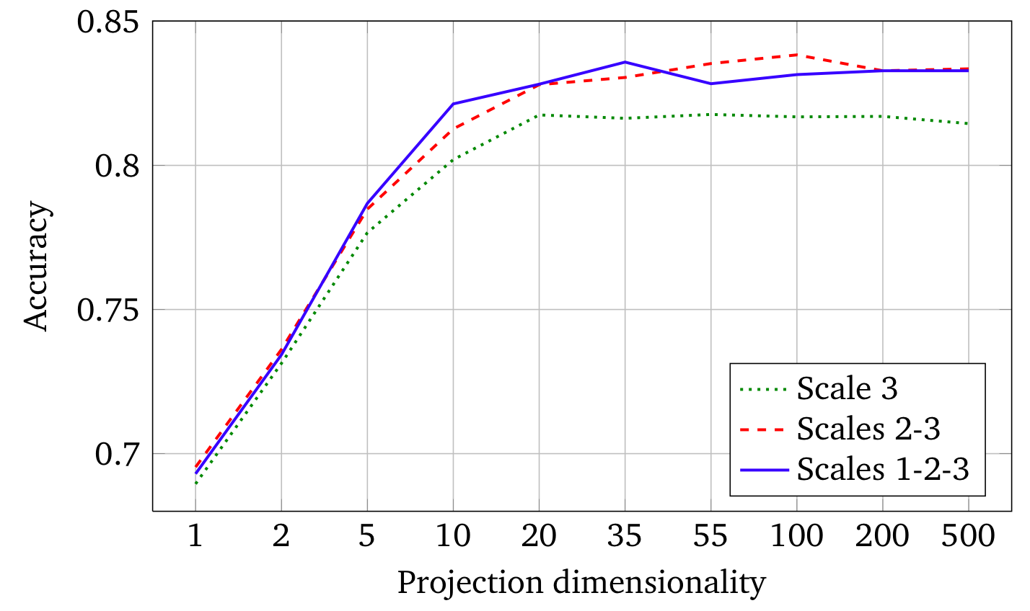
Experimental Results: Low-rank LDML metrics
L2: 67.8 %
Surprisingly good performance using very few dimensions
20 dimensional descriptor instead of 3456 dim. concatenated SIFT
just from linear combinations of the SIFT histogram bins
Notes:
28

Slide 29
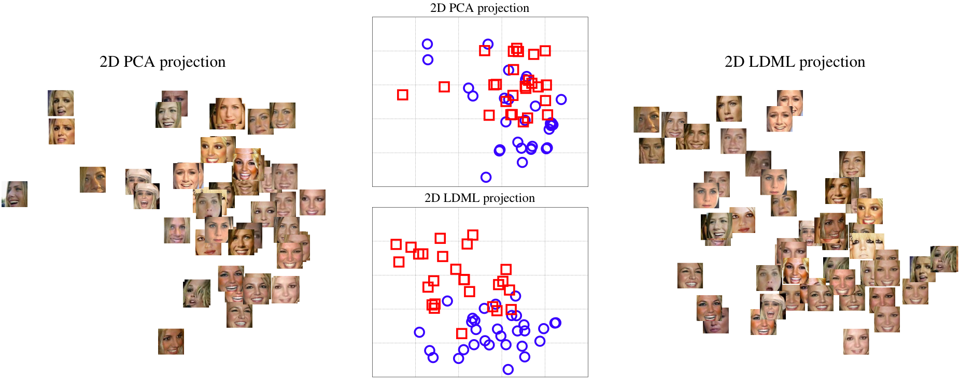
Comparing projections of LDML and PCA
Using PCA and LDML to find two dimensional projection of the faces of Britney Spears and Jennifer Aniston
pose
Notes:
29

Slide 30
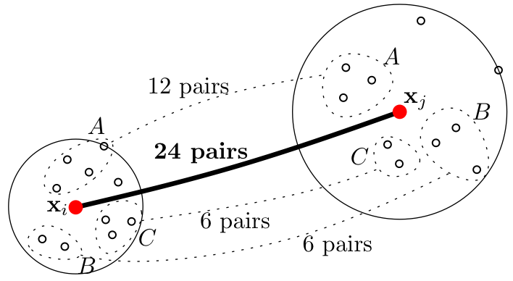
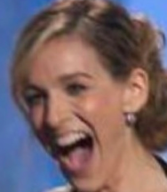
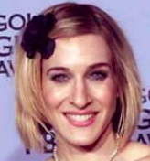
Marginalized k Nearest Neighbors
Nearest neighbour prediction on identify each face
Class probability given by fraction of neighbours of class
Compute marginal probability that both samples belong to same class
Counting pairs of neighbours with the same label
Notes:
30

Slide 31
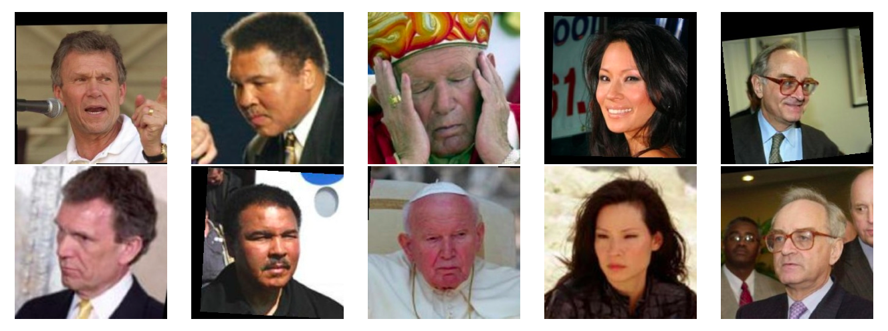
Marginalized kNN results
Examples where LDML fails, but MkNN succeeds
Observe the large variations in pose, expression
Notes:
31

Slide 32
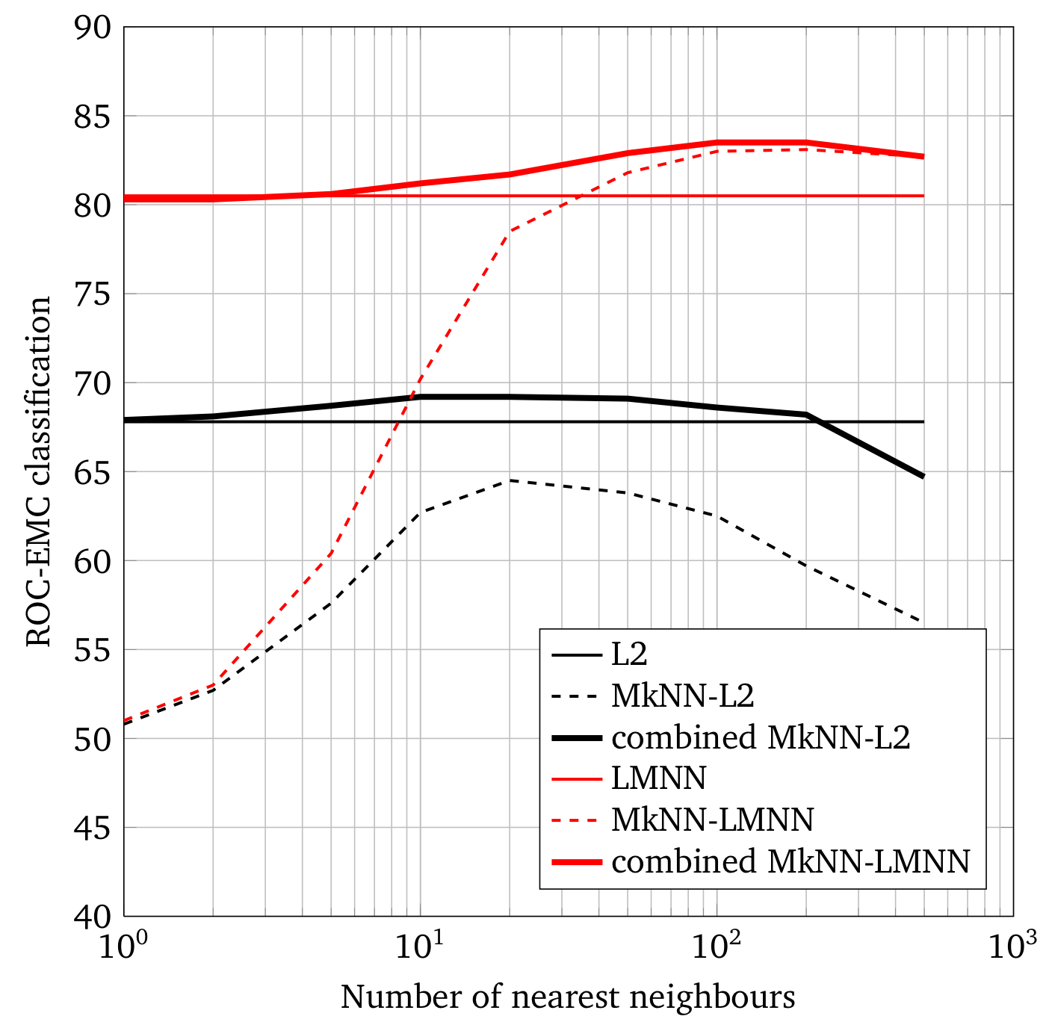
Marginalized kNN results
Performance as function of
number of neighbours
Neighbour metric L2 / LMNN
Again: using the right metric for the task at hand is very important
Performance comparable to LDML, methods complementary as a late fusion of the scores improves results to ~87.5%
Notes:
32

Slide 33
Benchmark comparison to other methods
Combining scores of LDML and MkNN further increases performance
State of the art results on the LFW benchmark
Method | Performance
Eigenfaces (CVPR ‘91) | 60.02
MERL (ECCV’08) | 70.52
3x3 Multi-Region Histograms (ICB’09) | 72.95
Nowak (CVPR’07) | 73.93
Hybrid descriptor-based (ECCV’08) | 78.47
LDML, funneled (ICCV’09) | 79.27
V1-like/MKL (CVPR’09) | 79.35
Hybrid, aligned (BMVC ‘09) | 83.98
Multiple LE + comp (CVPR ‘10) | 84.45
Combined b/g samples based methods, aligned (ACCV ‘09) | 86.83
LDML-MkNN, funneled (ICCV ‘09) | 87.50
Combined multishot, aligned (BMVC ‘09) | 89.50
Notes:
33

Slide 34
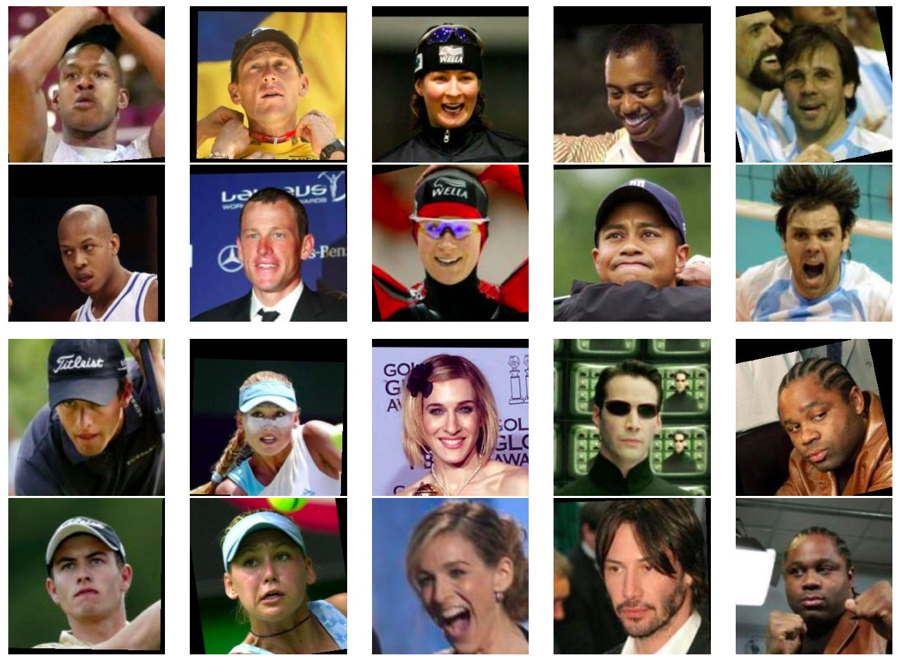
Examples of face-pairs need decision boundary
Combining scores of LDML and MkNN further increases performance
State of the art results on the LFW benchmark
Correctly Classified
Incorrectly Classified
Notes:
34

Slide 35
Overview
Metric learning methods
Metric learning for image annotation
Metric learning for face identification
Application to face clustering
Application to caption-based recognition
Notes:
35

Slide 36
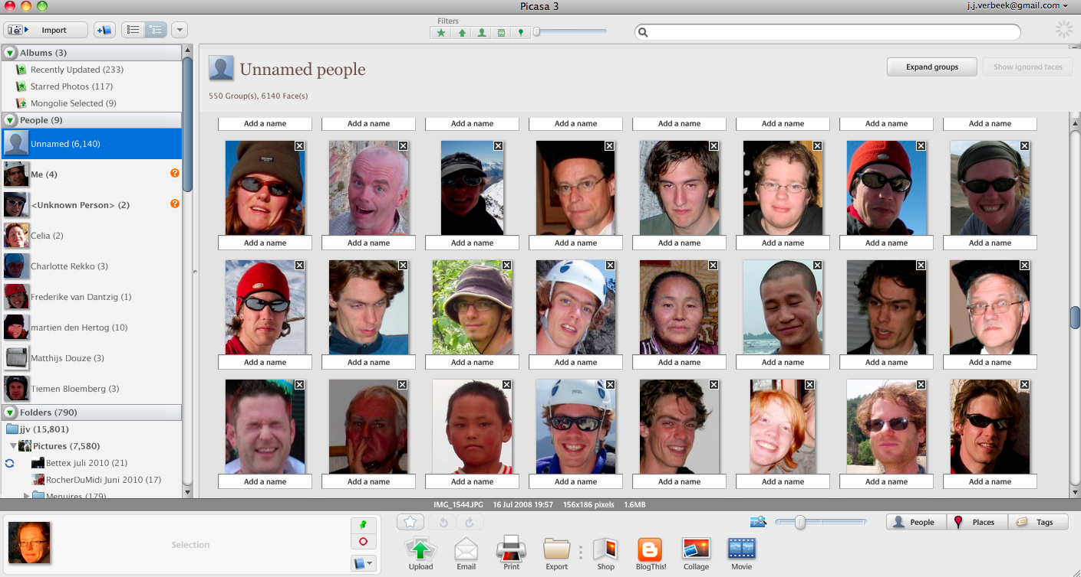
Application 1: Face Clustering
Example: grouping faces to speed-up labelling of personal photos
Picasa 3 screenshot
Notes:
36

Slide 37
Face Clustering experiment
Suppose user has two buttons
Button 1: Assign name to cluster of faces
Button 2: Assign name to a single face
Labelling cost: number of clicks needed to name all faces
Given a particular clustering, optimal labelling strategy
For each cluster
Assign cluster the name of most frequent person (1 click)
Correct all errors (1 click per remaining face)
Notes:
37

Slide 38
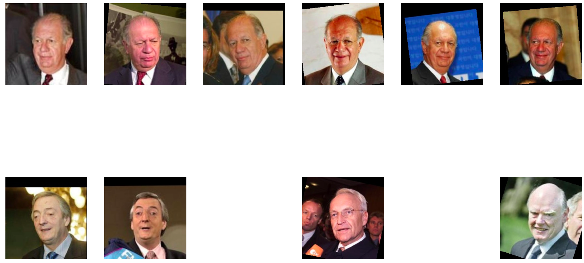
Face Clustering experiment
Assign cluster the name of most frequent person (1 click)
Correct all errors (4 clicks)
Notes:
38

Slide 39
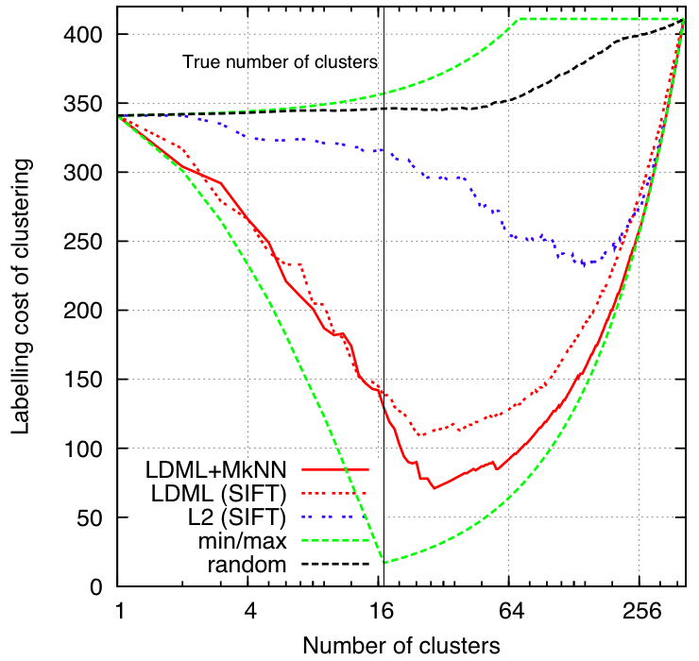
Face Clustering experiment
Hierarchical clustering based on L2 or learned metrics
Also compared to random clustering, min/max labelling cost
Clustering 411 faces of 17 people
Learned metrics yield significantly
better clustering results
Notes:
39

Slide 40
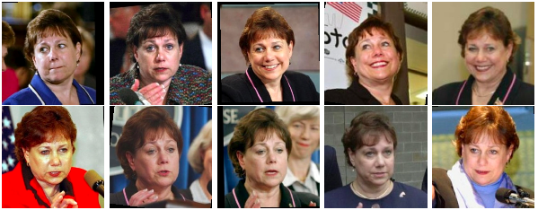
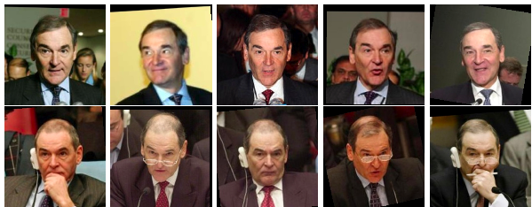
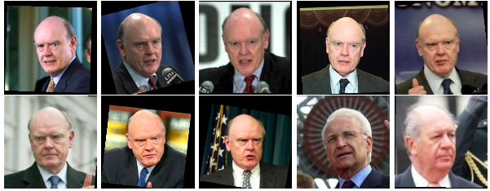
Example Clusters
Notes:
40

Slide 41
Overview
Metric learning methods
Metric learning for image annotation
Metric learning for face identification
Application to face clustering
Application to caption-based recognition
Notes:
41

Slide 42
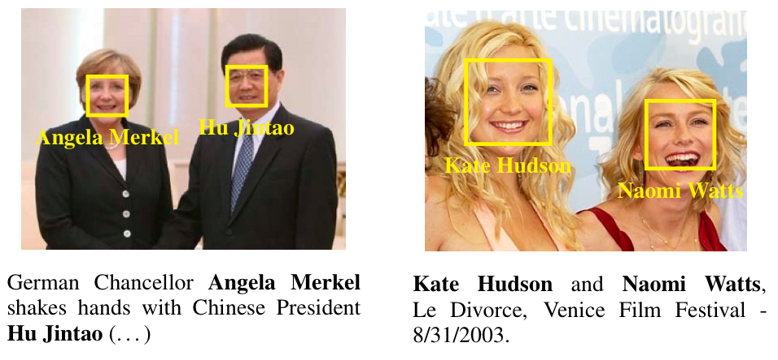
Application 2: Caption-based recognition
Recognition without any labelled training examples [Berg et al 2004]
Automatically detected faces from image, and names from caption
Missed faces, erroneous face detections
People not mentioned in caption, names missed
Notes:
42

Slide 43
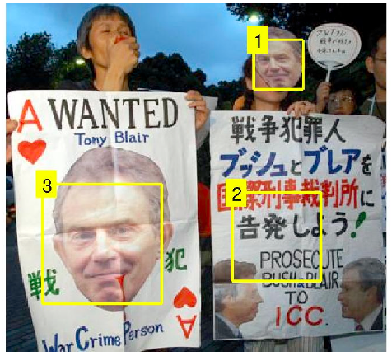
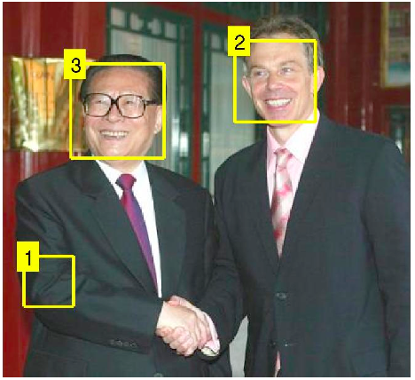
Associating names and faces using similarities
Experiments on 20.000 images from Yahoo! News
George W. Bush
Tony Blair
Junichiro Koizumi
Tony Blair
David Kelly
Jiang Zemin
Notes:
43

Slide 44
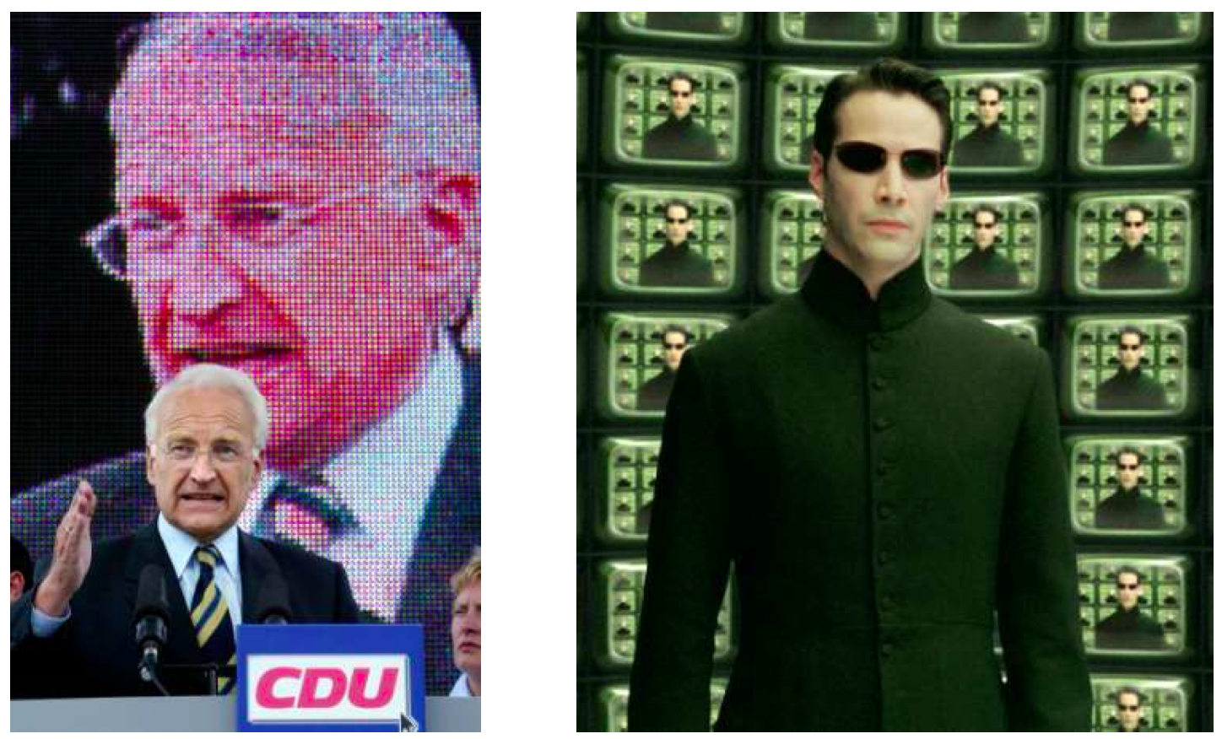
Caption-based face recognition
Iteratively optimize name-face matching per image, keeping rest fixed
Assumptions on name-face assignments in an image-caption pair
People appear once per image
A face belongs to only one person
Faces only assigned to names in the caption, or discarded
Notes:
44

Slide 45
Direct similarity-based approach
Maximize the sum of similarities between faces assigned to same name
Fixed cost to discard a face [Guillaumin et al. 2008]
Compute for each face total sum of similarities for each possible name
Solve assignment problem per image using Hungarian algorithm
Notes:
45

Slide 46
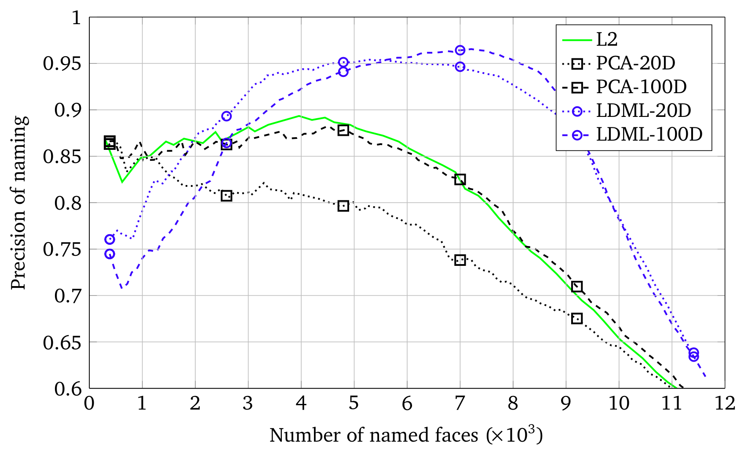
Caption-based recognition similarity-based
Weights defined using distance from L2, PCA, LDML
PCA does not help: it preserves distances
LDML: distances emphasise variations relevant for identity
Notes:
46

Slide 47
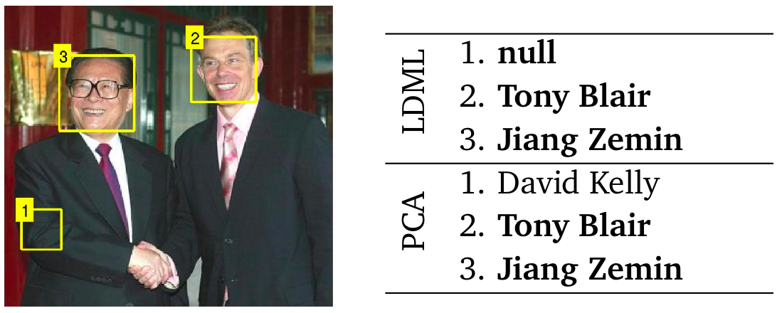
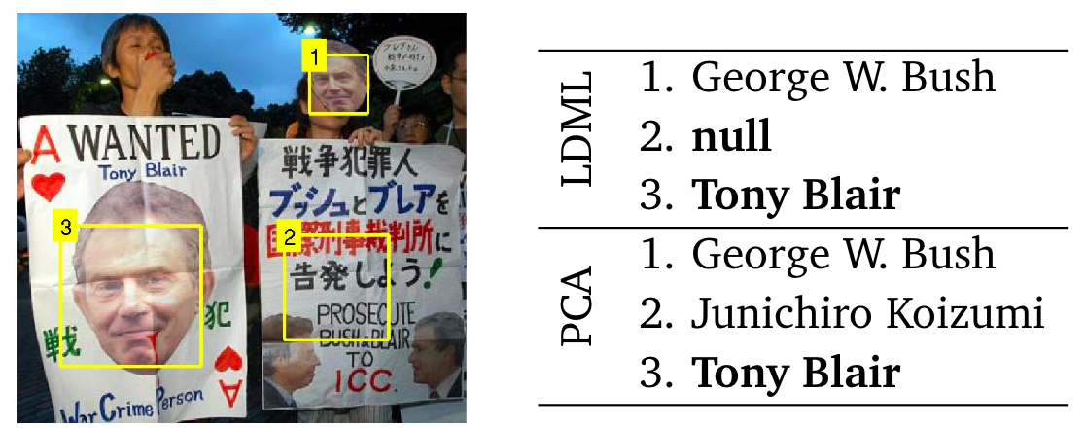
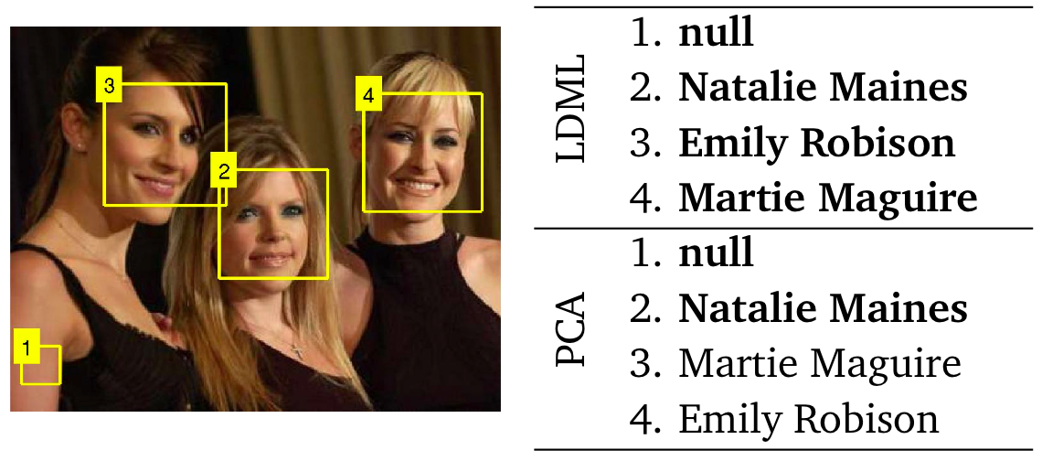
Example name-face associations
Notes:
47

Slide 48
Summary & Conclusion
Presented three simple metric learning methods
TagProp: weighted nearest neighbour image annotation method
LDML: logistic discriminant metric learning
MkNN: marginalized k nearest neighbour classification
Sate of the art performance on challenging vision tasks
Notes:
48

Slide 49
References
E. Nowak and F. Jurie. Learning visual similarity measures for comparing never seen objects. CVPR 2007.
C. Bishop. Pattern Recognition and Machine Learning. Springer, 2006.
L. Yang and R. Jin. Distance metric learning: A comprehensive survey. Technical report, Department of Computer Science & Engineering, Michigan State University, 2006.
M. Guillaumin, T. Mensink, J. Verbeek, and C. Schmid. TagProp: Discriminative metric learning in nearest neighbor models for image auto-annotation. ICCV 2009.
M. Guillaumin, J. Verbeek, and C. Schmid. Is that you? Metric learning approaches for face identification. ICCV 2009.
M. Everingham, J. Sivic, and A. Zisserman. ‘Hello! My name is... Buffy’ - automatic naming of characters in TV video. BMVC 2006.
T. Berg, A. Berg, J. Edwards, M. Maire, R. White, Y. W. Teh, E. Learned- Miller, and D. Forsyth. Names and faces in the news. CVPR 2004.
M. Guillaumin, T. Mensink, J. Verbeek, and C. Schmid. Automatic face naming with caption-based supervision. CVPR 2008.
Notes:
49

