Slide 1
EpicFlow: Edge-Preserving Interpolation of Correspondences for Optical Flow
Jerome Revaud
Joint work with:
Philippe Weinzaepfel
Zaid Harchaoui
Cordelia Schmid
Inria
Notes:
Redire le titre quoi qu’il arrive

Slide 2
Optical flow estimation is challenging!
Main remaining problems:
large displacements
occlusions
motion discontinuities

Slide 3
Optical flow estimation is challenging!
Main remaining problems:
large displacements
occlusions
motion discontinuities
Our approach: « EpicFlow »
Epic: Edge-Preserving Interpolation of Correspondences
leverages state-of-the-art matching algorithm
invariant to large displacements
incorporate an edge-aware distance:
handles occlusions and motion discontinuities
state-of-the-art results

Slide 4
Related work:
Variational optical flow [Horn and Schunck 1981]
energy:
Solutions for handling large displacements
Minimization using a coarse-to-fine scheme [Horn’81, Brox’04, Sun’13, ..]
iterative energy minimization at several scales
displacements are small at coarse scales
Addition of a matching term [Brox’11, Braux-Zin’13, Weinzaepfel’13, ..]
penalizing the difference between flow and HOG matches
color/gradient constancy smoothness constraint

Slide 5
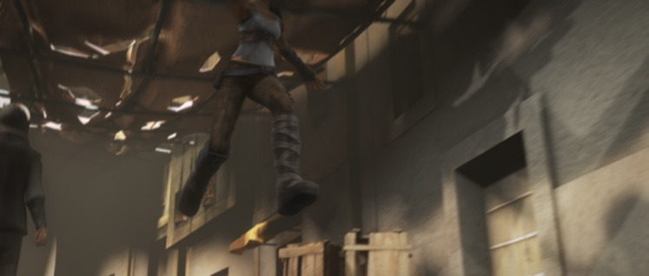
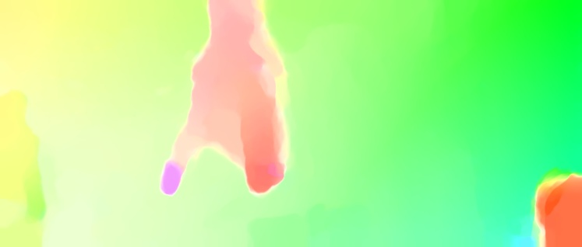
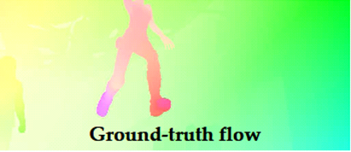
Related work: coarse-to-fine minimization
Problems with coarse-to-fine:
flow discontinuities overlap at coarsest scales
errors are propagated across scales
no theoretical guarantees or proof of convergence!
1024x436 pixels
Coarsest level (59x26 pixels)
Full-scale estimate
Estimation at coarsest scale
EpicFlow

Slide 6
Overview of our approach
Avoid coarse-to-fine scheme
Other matching-based approaches [Chen’13, Lu’13, Leordeanu’13]
less robust matching algorithms (eg. PatchMatch)
complex schemes to handle occlusions & motion discontinuities
no geodesic distance
(SED)
(DeepMatching)
6

Slide 7
Overview of our approach
(DeepMatching)

Slide 8
Dense Interpolation
DeepMatching [Weinzaepfel et al. 2013]
5000 matches / image pair
Does not respect motion boundaries

Slide 9
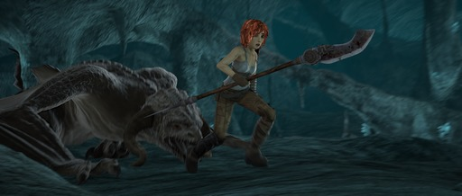
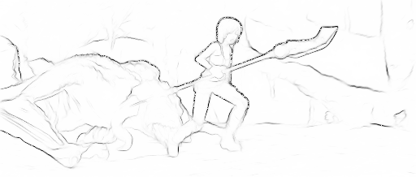
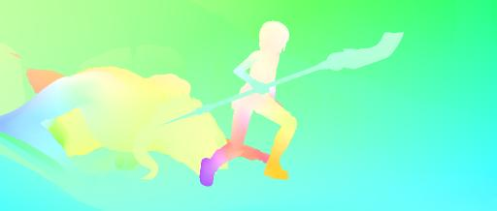
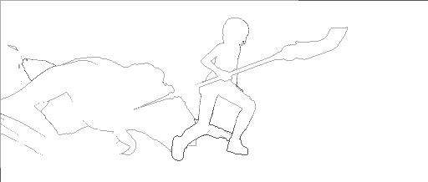
Dense Interpolation
Assumption:
motion boundaries are mostly included in image edges
image
contours (SED, [Dollar and Zitnick, 2013])
ground-truth flow
motion boundaries

Slide 10
Dense Interpolation: edge-aware geodesic distance
Replace Euclidean distance with edge-aware distance to find NNs
Geodesic distance:
Anisotropic cost map =
image edges
Cost of a path: sum of the cost of all traversed pixels
Geodesic distance: minimum cost among all possible paths
q
minimum path
p

Slide 11
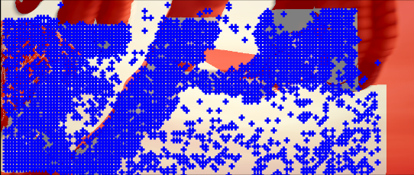
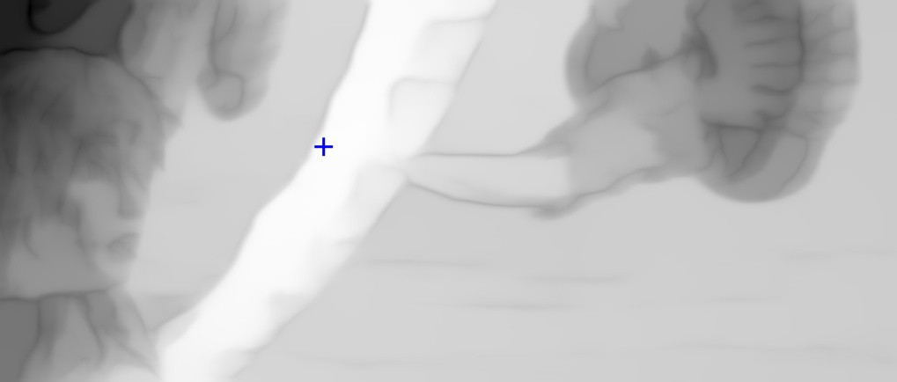
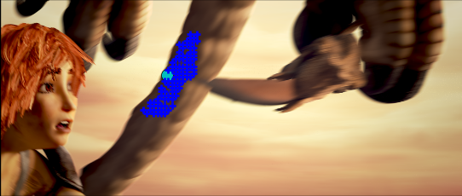
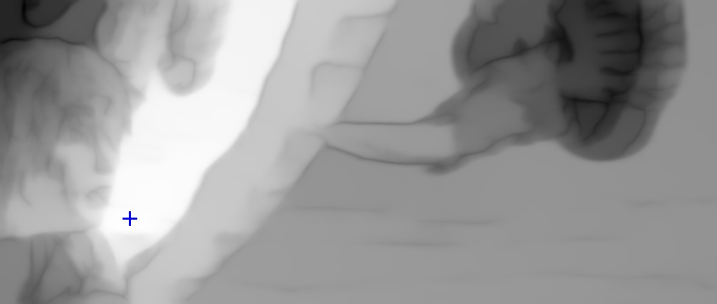
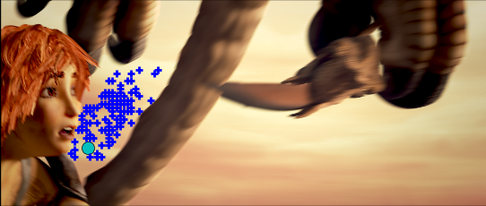
Dense Interpolation: edge-aware geodesic distance
Occlusions
Image edges
Matches
Geodesic distance
100 closest matches
Geodesic distance
100 closest matches

Slide 12
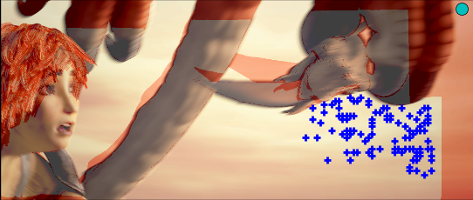
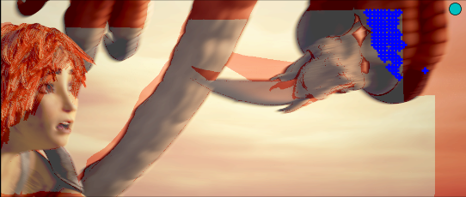
Dense Interpolation: edge-aware geodesic distance
Occlusions
Image edges
Matches
Image edges
Geodesic distance
100 closest matches
Euclidean distance
100 closest Euclidean matches

Slide 13
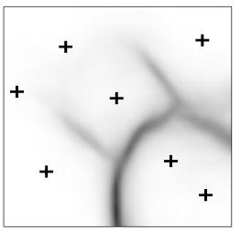
Dense Interpolation: approximated geodesic distance
Approximation
Assign each pixel to its (geodesic) closest match
Compute geodesic distances in a graph of neighboring matches:
~5000 nodes=matches ➔ instead of 1M pixel
match
positions
Contour map
Pixel assignement
to closest match
Match graph

Slide 14
Variational refinement
One-level variational minimization
initialization = dense interpolation
classic optimization

Slide 15
Experimental results: datasets
MPI-Sintel [Butler et al. 2012]
sequences from a realistic animated movie
large displacements (>20px for 17.5% of pixels)
atmospheric effects and motion blur
Ambush_4
Temple_3

Slide 16
Experimental results: datasets
KITTI [Geiger et al. 2013]
sequences captured from a driving platform
large displacements (>20px for 16% of pixels)
real-world lightings, repetitive textures (roads, trees…)

Slide 17
Results: with/without refinement
Ground-truth
Dense
interpolation
(before variational
refinement)
error: 5.9
error: 4.2
EpicFlow
(after variational
refinement)
error: 5.7
error: 3.9
temple_3 42
Cave_2 16
Ambush_5 22

Slide 18
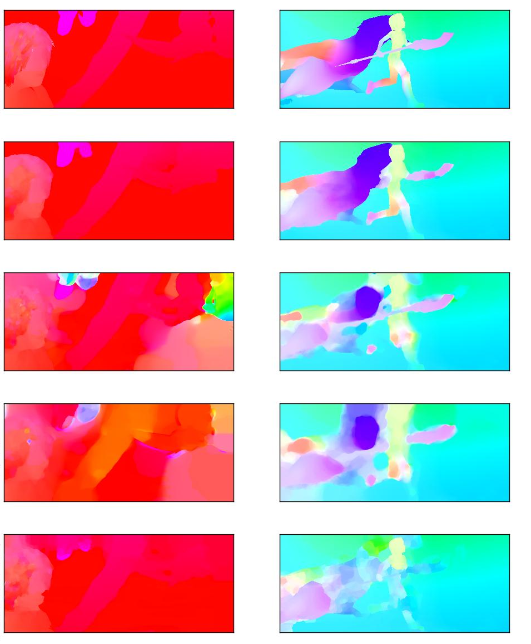
Ground-truth
EpicFlow
error: 5.7
error: 3.9
MDP-Flow
error: 38.9
error: 9.2
LDOF
error: 52.8
error: 10.5
Classic+NL
error: 11.8
error: 11.6
temple_3 42
cave_2 16
ambush_5 22

Slide 19
Comparison to the state of the art
Average Endpoint Error (lower is better):
Timings:
Method | Error on MPI-Sintel | Error on KITTI | Timings
EpicFlow | 6.28 | 3.8 | 16.4s
TF+OFM | 6.73 | 5.0 | ~500s
DeepFlow | 7.21 | 5.8 | 19s
NLTGV-SC | 8.75 | 3.8 | 16s (GPU)

Slide 20
Sensitivity to edge detectors and matching algorithms
Evaluation with different:
input matchings
Kd-trees assisted PatchMatch (KPM) [He and Sun, 2012]
DeepMatching (DM) [Weinzaepfel et al. 2013]
edge detectors
SED [Dollar and Zitnick 2013], gPb [Arbelaez et al. 2011], Canny
Edges | Matching | MPI-Sintel (train) | KITTI (train)
SED | KPM | 5.76 | 11.3
SED | DM | 3.68 | 3.3
Edges | Matching | MPI-Sintel (train) | KITTI (train)
gPb | DM | 4.16 | 3.4
Canny | DM | 4.55 | 3.3
none (Euclidean distance) | DM | 4.61 | 3.6

Slide 21
Comparison with coarse-to-fine
Experimental protocol:
Same input matching (DeepMatching)
Same input contours (for local smoothness)
Same training set
Average endpoint-error:
More detailed experiments in the paper
Method | MPI-Sintel (train) | KITTI (train) | Time
Coarse-to-fine | 4.095 | 4.422 | 25.0s
EpicFlow | 3.686 | 3.334 | 16.4s

Slide 22
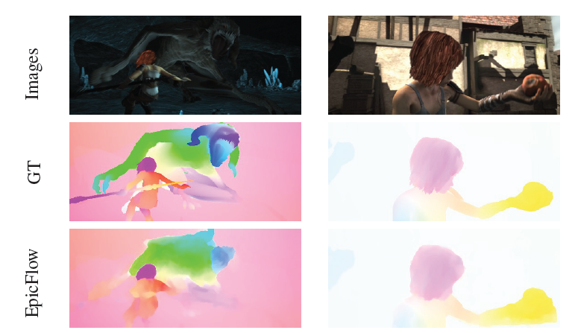
Failure cases
Missing matches
Missing contours

Slide 23
Conclusion
Excellent results
Code is available online at http://lear.inrialpes.fr/software

